Slide 1
Reporting Research Results

Slide 2
The Research Report Package
Written
Report
Oral Presentation
Notes:
old written report (bring example)
new approach
--bullet points + graphs
--usu prepped in PowerPoint
--sometimes, rept is just a copy of pres slides
bad idea!
characs of a good pres and a good report differ

Slide 3
Qualities of an Effective …
Report:
Presentation:
Provides complete information
Transcends the moment
Has archival value
Emphasizes main points
Is in the moment
Guides and controls audience attention
Notes:
good report
• complete information (Nuts and Bolts, but reader controls the way to see)
• transcends the moment; referred to repeatedly and by those absent from pres (one cannot hide/vague, ppl will read it three times)
• archival value
good presentation
• presenter guides and controls audience attention (you controls what you want the audience to see)
• slide cover main points in few words, supplemented w/ images (many images, more vivid with non-verbal emphasis, pause)
• in the moment

Slide 4
PowerPoint Design
Effective Communication and Positive Impressions
Notes:
all examples of student pres slides

Slide 5
First Impressions Count

Slide 6

Notes:
Good example

Slide 7

Winter Sport Purchases By
University of Missouri Students
Notes:
Good example

Slide 8

Kelsey Boardsen
Erin Land
Lindsey Ralls
Charlie Bambini
Notes:
Good example

Slide 9
Keep It Simple

Slide 10

B&B Bagel Company
Boiled and Baked
Located on South Side
Owned by Brad and Becky Newkirk
Notes:
Good example

Slide 11

About Tiger Garden
Full service floral shop
Located in Agriculture Building
Kim Martin- Supervisor
8-15 student employees
Notes:
good example

Slide 12
Keep It Short

Slide 13


Response Rate
7 ineligible for answering questionnaire because they weren’t Mizzou students
15 people declined taking the survey
Response rate of 91.18%
Contacted: 182
Refusals: 15
Not eligible: 7
182-15-7=160 completed questionnaires
Eligibility rate: 160/167=.95808
Denominator: 182 X .95808 = 174.37056
Response rate: 160/174.37056 = .91759 or 91.18%
Notes:
Example of a bad slide—too wordy, font too small

Slide 14
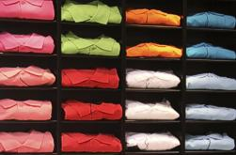
TEXTILE & APPAREL
Using data to ensure compliance, reduce costs and protect brand image.
Monitor competitive movements and predict market trends
The ability to search by their products, materials, even their brand names to quickly identify potential counterfeiters and monitor quotas.
Identifying new manufacturers and tracking existing suppliers with exclusive agreements to ensure compliance.
Investigating companies involved in counterfeiting their brands and other gray market activities.
Notes:
Too wordy; font too small

Slide 15
Make It Pleasant

Slide 16

Carolina Rodgers
David Waterhouse
Rita McCallister
George Planchette
Notes:
Bad example

Slide 17
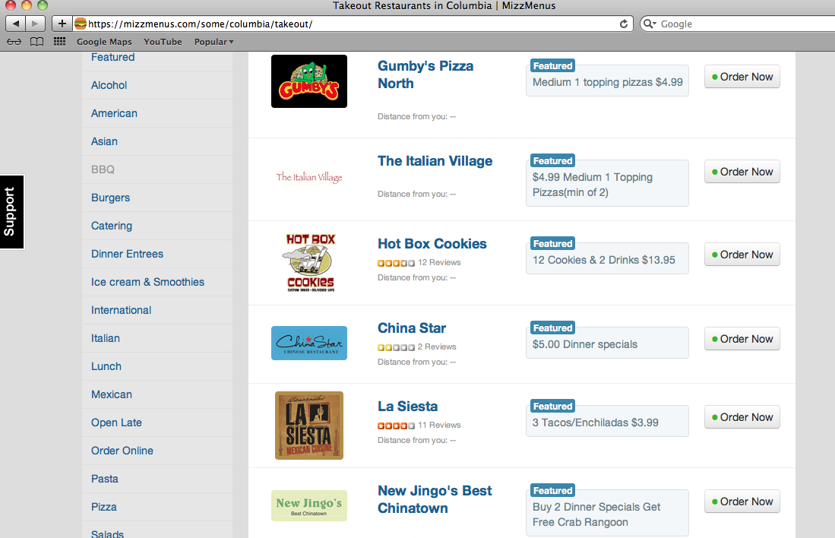
What is Mizzmenus?
Franchise started from the company OrderUp
OrderUp is a company started from college students who saw an opportunity to enter emerging markets
One stop online ordering for delivery or takeout
Notes:
Bad example

Slide 18
Use Animation
to Focus Attention

Slide 19
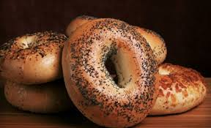
Research Objectives
Assess Columbia residents’ awareness of B&B Bagel
Customer motives for dining out
Demand for second B&B Bagel on West Side
Importance of delivery/online ordering option
Notes:
Good example

Slide 20
Bad Animation

Slide 21
Research Objectives
How many college students are aware of Umbria Restaurant?
How do students find out about new restaurants?
What advertising tools affect college students the most?
What draws a student to a new restaurant?
Notes:
Bad animation example

Slide 22
Use Transitions

Slide 23
Kampai Sushi Bar
Recommendations
Notes:
Good example

Slide 24

Key Results
Notes:
Good example

Slide 25
Not-So-Good Graphs

Slide 26
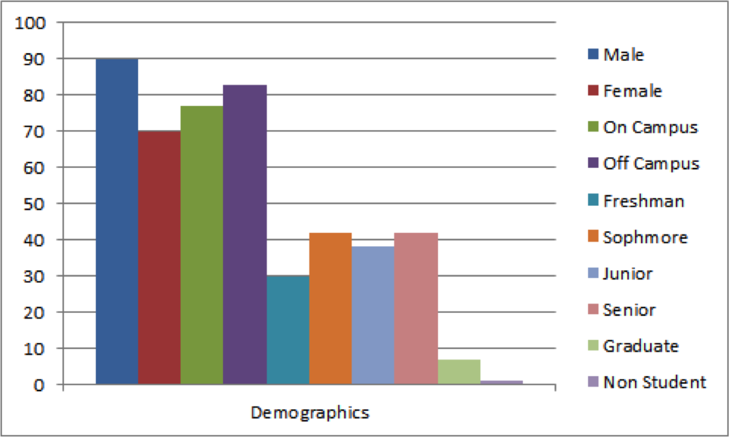
Notes:
Bad graph; three different demographic variables smashed together in one graph

Slide 27
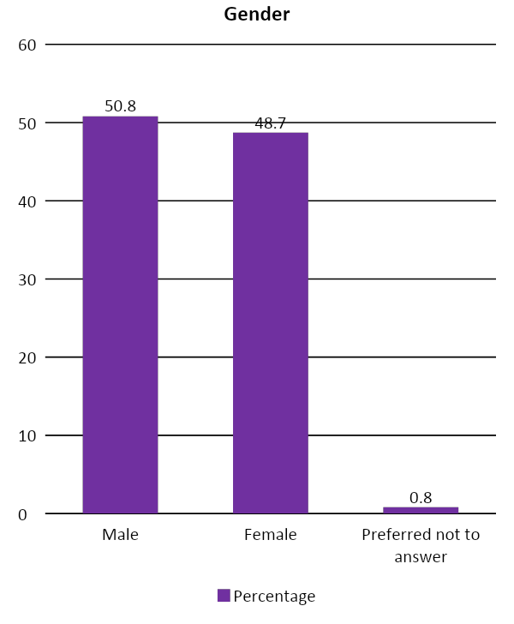
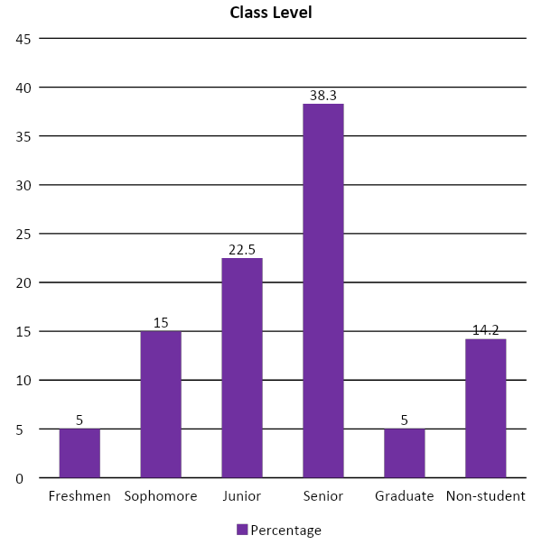
Demographic Variables
Notes:
Bad example; present only one graph per slide

Slide 28
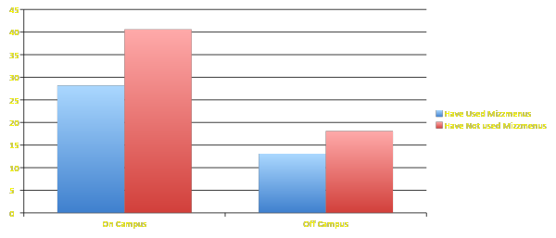
Key Results
Do on campus students use delivery more than off campus students?
Notes:
Bad example; avoid 3D
Label fonts are too small

Slide 29
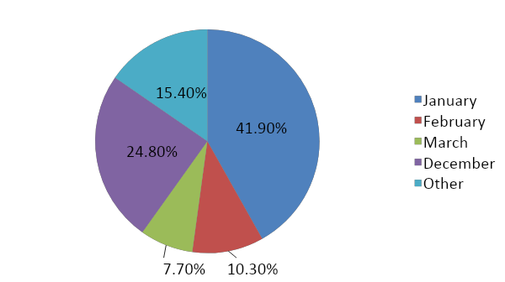
Results
What is the most popular month for Mizzou students to go skiing?
Notes:
I ban pie charts from my class; bar or column charts are almost always more interpretable

Slide 30
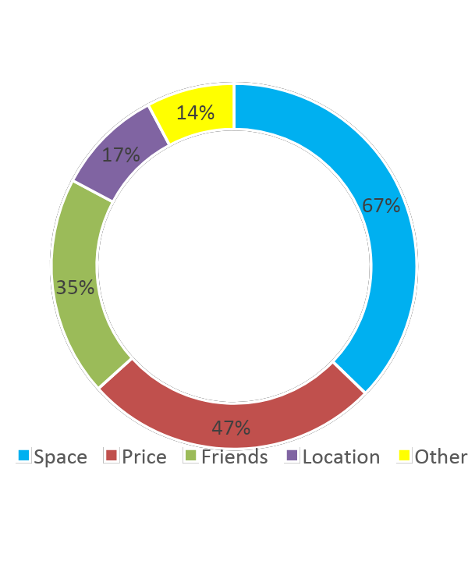
Why they chose The Pointe
Space was biggest draw
Price and Friends followed closely behind
Notes:
I ban these too; hard to interpret; bar or column chart better.

Slide 31
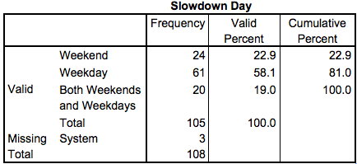
Weekday versus weekend
Majority of students perceived the issues to be worse during weekdays
Notes:
Bad example -- Never paste SPSS output into a presentation slide

Slide 32
Better Graphs

Slide 33
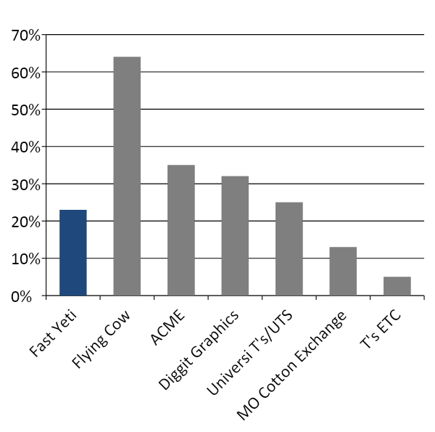
AWARENESS
23% of students in our sample were aware of Fast Yeti.
Notes:
Better, but try to avoid slanted labels

Slide 34
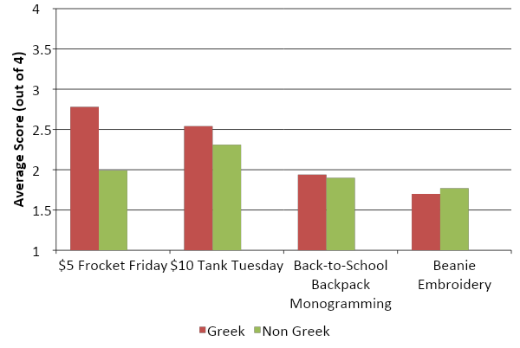
PROMOTION PREFERENCES BY ORGANIZATION
Notes:
Good example

Slide 35
Presentation key requirement:
1. Include required sections: background, research objective and research questions, method, result, recommendation, and limitation. Important: must have one difference-research question in the presentation.
2. Have evidence-based recommendations
3. Slide design:
Never paste the table directly from Qualtrics. Always format it to highlight the insight. And don’t overload the slide.
Use only bar chart: label the legends, x and y-axis, RQ, unit of your measure. Use big enough fonts.
Use color to highlight your point or to differentiate between groups to answer the difference type RQ.

